Slide 1


Slide 2
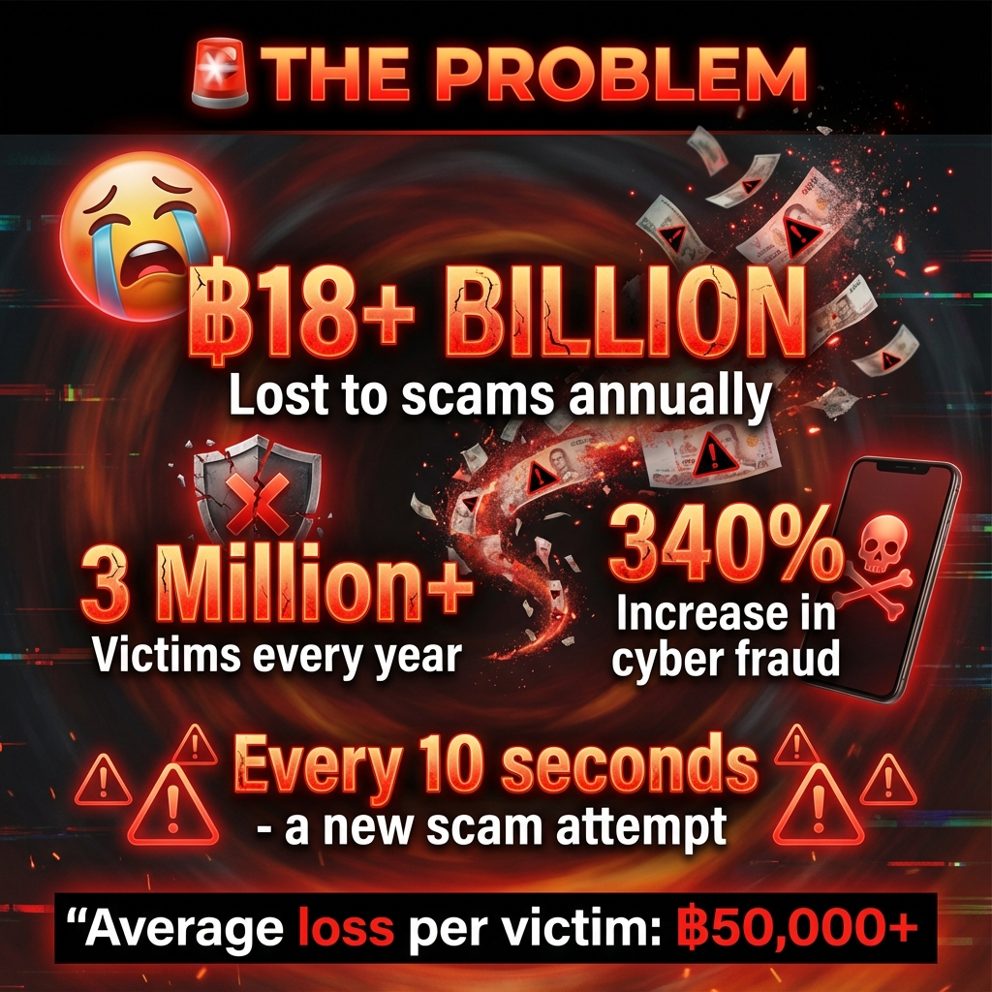

Slide 3


Slide 4
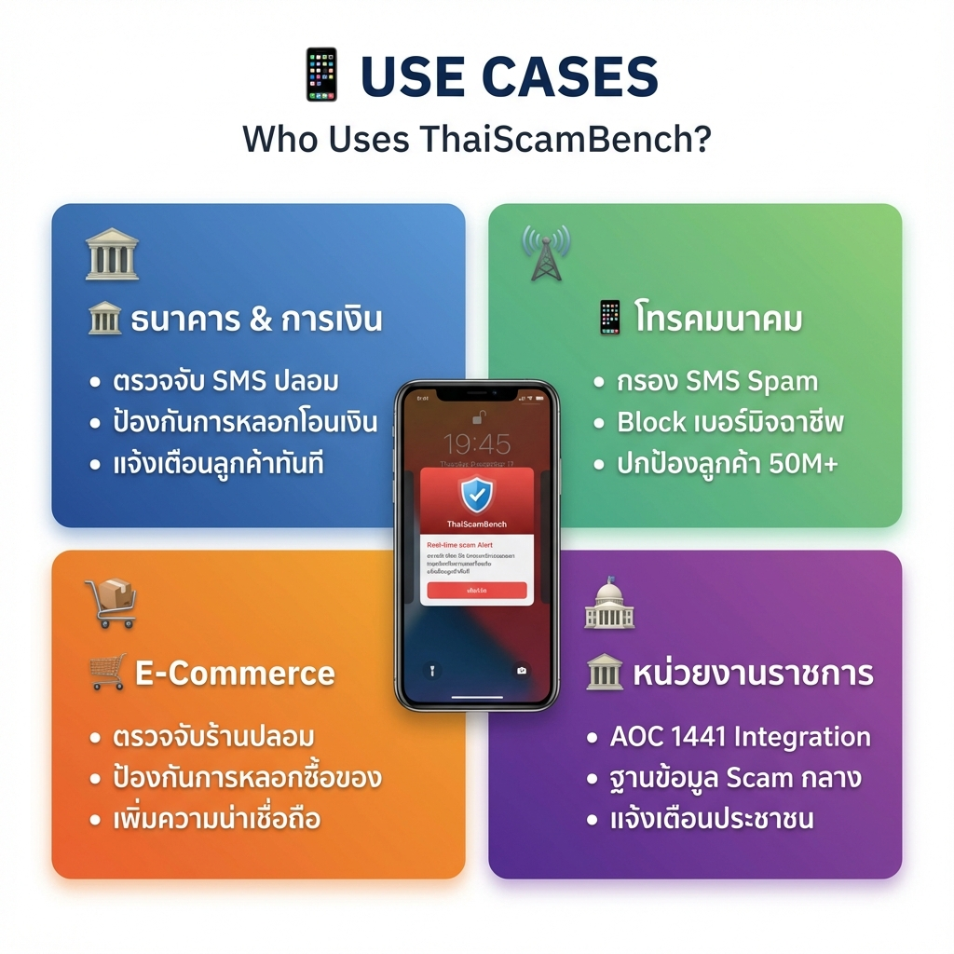

Slide 5
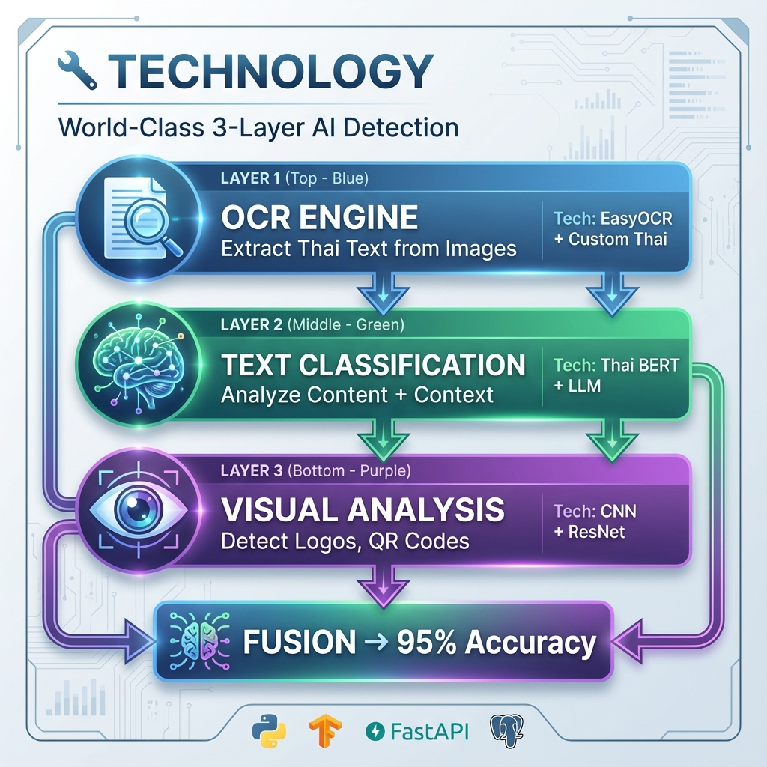

Slide 6
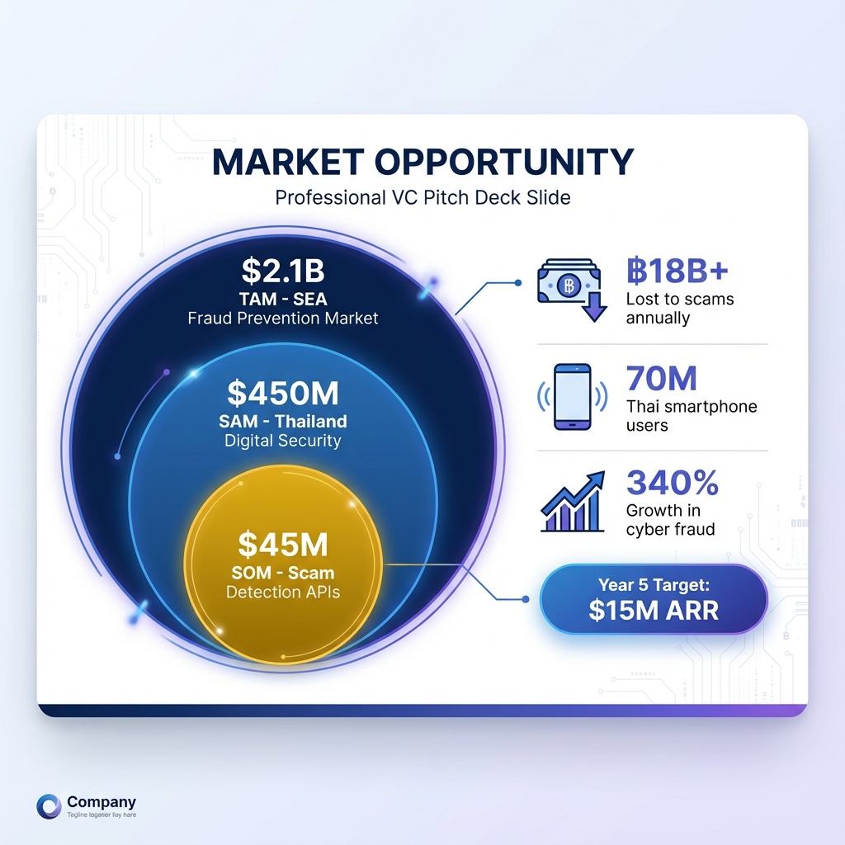

Slide 7
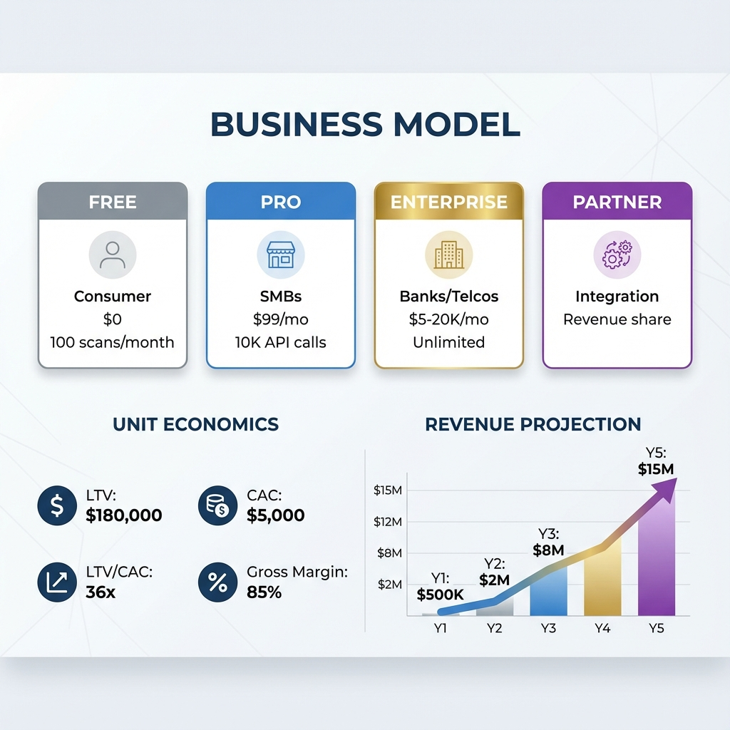

Slide 8
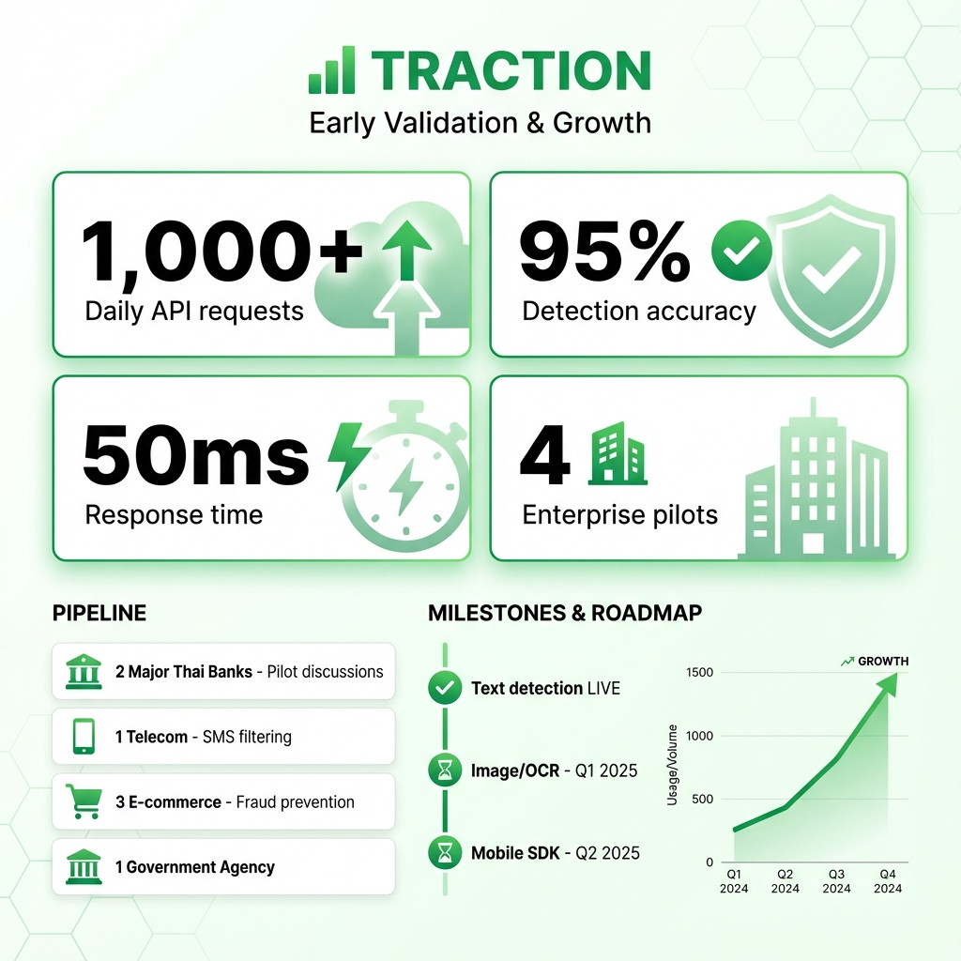

Slide 9
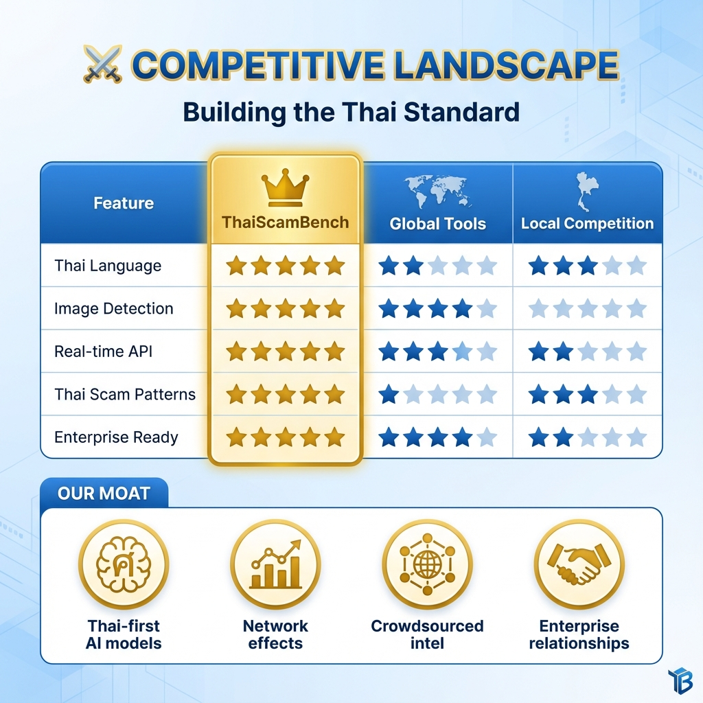

Slide 10
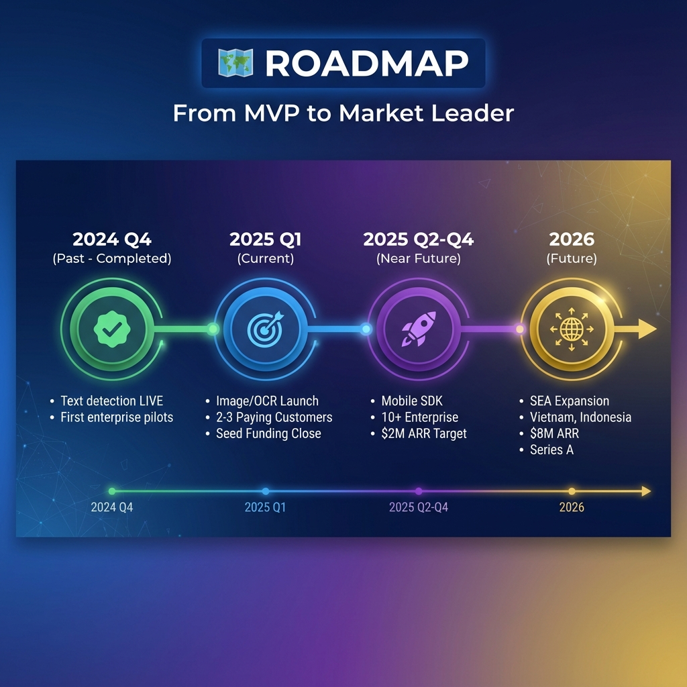

Slide 11
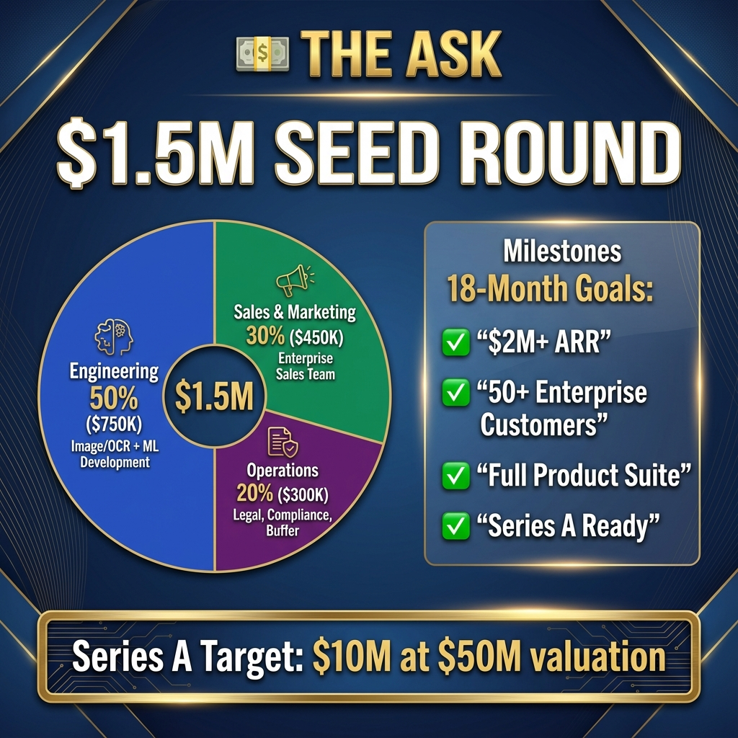

Slide 12


Slide 13
👥 TEAM
Built by Security & AI Experts
Founders:
- CEO: 10+ years fintech, ex-bank executive
- CTO: AI/ML specialist, ex-Google/Meta
- CPO: Product leader, cybersecurity background
Advisory Board:
- Former Bank of Thailand executive
- Cybersecurity expert
- Fintech founder

